Slide 1







AI & ML
USED IN AMAZON
By
Mohit Sharma
Luvkush Sharma
Uday Pratap Singh
Dheeraj Sharma

Slide 2
TABLE OF CONTENTS
Introduction to Amazon.
Introduction to technologies that used in amazon.
ML Models used in Amazon.
Comparative Analysis of technology with other companies.
Conclusion and future scope.

Slide 3

INTRODUCTION
Amazon is one of the world's largest and most influential e-commerce and technology companies, founded in 1994 by Jeff Bezos.
Beyond retail, Amazon has diverse business interests including streaming services (Prime Video), smart devices (Echo, Fire tablets), and logistics (Amazon Logistics) among others.
Amazon's commitment to innovation extends to ventures like Alexa-enabled devices, Amazon Fresh grocery services, and original content production through Amazon Studios.

Slide 4

Global Presence
Amazon has a global presence with operations in over 200+ countries and over 185 distribution centers worldwide.
The company generates over $$554.03 Billion in annual revenue and employs over 1.5 million people globally.
Amazon's dominance in e-commerce has made it a household name and a transformative force in the retail industry.

Slide 5


INTRODUCTION TO TECHNOLOGY IN AMAZON
1. Personalized product recommendations:
Amazon uses AI algorithms to analyze customer purchase history, browsing behavior, and demographic data to generate personalized product recommendations.
This system, known as Amazon's "recommendation engine," is a significant factor in the company's success, as it helps customers discover new products they might be interested in and increases the likelihood of purchases.

Slide 6

On-site Recommendations
1) “RECOMMENDED FOR YOU, THOMAS”

Slide 7

2) FREQUENTLY BOUGHT TOGETHER
freq-bought-together

Slide 8
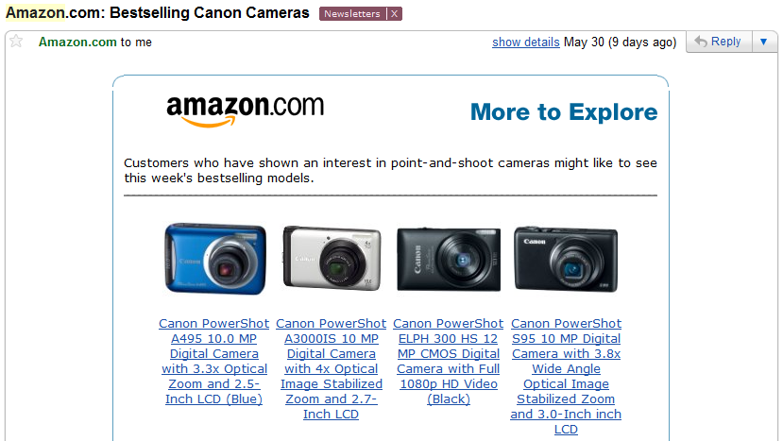
Off-site Recommendations with Email
“THIS WEEK’S BEST SELLING CANON MODELS”

Slide 9


2. Fraud detection:
Amazon employs AI and ML to identify and prevent fraudulent transactions. These algorithms analyze patterns in customer behavior, payment information, and shipping addresses to flag potential fraudulent activities. This helps Amazon protect its customers from financial losses and maintain the integrity of its marketplace.
3. Customer service:
Amazon uses AI-powered chatbots and virtual assistants to provide 24/7 customer support. These chatbots can answer frequently asked questions, resolve common issues, and collect feedback from customers, reducing the burden on human customer service agents.

Slide 10
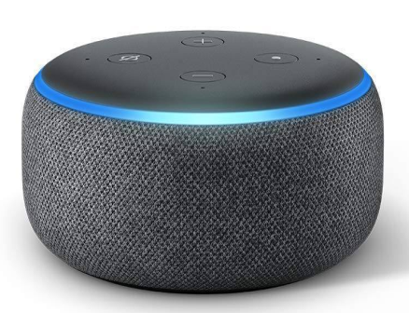
4. Amazon Alexa
Natural Language Understanding: Alexa utilizes AI to understand and respond to natural language queries, perform tasks, and control smart home devices.
Continuous Learning: Machine learning helps Alexa improve its responses and understand user preferences over time.
Amazon Alexa has been integrated into a wide range of devices and services across various industries. The integration of Alexa extends beyond Amazon's own devices, allowing users to interact with the voice assistant in different contexts. Here are some common areas where Amazon Alexa is integrated:
In-Car Systems: Some automotive manufacturers have integrated Alexa into their in-car infotainment systems. This allows drivers to use voice commands to control navigation, play music, and access other Alexa skills while on the road.

Slide 11
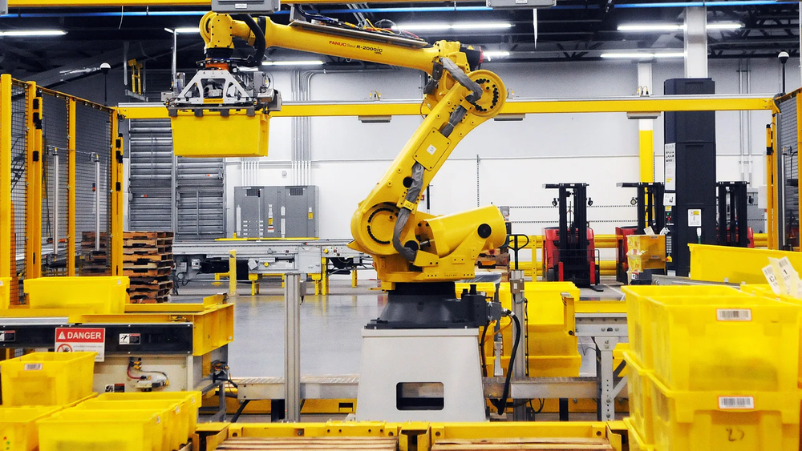
2. Wearables: Alexa is integrated into some wearable devices, including certain smartwatches and fitness trackers. Users can use voice commands to perform various tasks without having to use their hands.
3. Third-Party Apps and Skills: Developers can create third-party apps and skills for Alexa, expanding its capabilities. Users can enable these skills to perform specific tasks, such as ordering food, checking the news, or playing games.
4. Business and Productivity Applications: Some business-focused applications and productivity tools have integrated Alexa to provide hands-free assistance in a work environment. This includes features like scheduling, reminders, and accessing information.
5. Robotics and Automation
Amazon Robotics: AI and ML are integral to Amazon's robotics technology in warehouses, optimizing inventory management, and automating tasks like picking, packing, and sorting.

Slide 12

6. Data Analysis and Optimization
Big Data Processing : ML algorithms analyze massive amounts of data to optimize processes, predict demand, and improve logistics and supply chain operations.

Slide 13
Here are some specific examples of AI and ML technology used in Amazon:
Amazon Recognition: This service uses ML to identify objects, people, and activities in images and videos. It is used to power features such as image search and product recognition.
Amazon Polly: This service uses ML to convert text to speech. It is used to power features such as Audible audiobooks and Echo devices.
Amazon Comprehend: This service uses NLP to extract information from text. It is used to power features such as document summarization and sentiment analysis.
Amazon SageMaker: This service is a fully managed ML platform that makes it easy for developers to build, train, and deploy ML models.

Slide 14
Amazon uses a variety of machine learning models across different aspects of its business.
Recommendation Systems
Amazon employs machine learning models to power its recommendation systems, suggesting products to users based on their browsing and purchasing history.
Collaborative filtering, content-based filtering, and deep learning models may be used to enhance the accuracy of product recommendations.
Forecasting and Demand Planning
Machine learning models are likely used for demand forecasting to optimize inventory management and ensure timely product availability.
Time series analysis, regression models, and deep learning approaches may be applied for accurate demand prediction.

Slide 15
Voice Recognition and Natural Language Processing
Products like Amazon Echo and Alexa utilize machine learning models for natural language processing (NLP) and voice recognition.
Deep learning models, such as recurrent neural networks (RNNs) and convolutional neural networks (CNNs), may be used for speech recognition.
Computer Vision for Automated Processes
In Amazon's warehouses, computer vision models could be employed for tasks such as object detection, quality control, and inventory management.
Convolutional Neural Networks (CNNs) and other computer vision techniques might be used for image analysis.

Slide 16
Personalization on the Amazon Website
Personalized content on the Amazon website may be driven by machine learning models that analyze user behavior and preferences.
Clustering, collaborative filtering, and reinforcement learning may be applied to personalize the user experience.
Fraud Detection
Amazon employs machine learning algorithms to detect and prevent fraudulent activities, such as payment fraud and account takeovers.
Anomaly detection, pattern recognition, and supervised learning techniques may be used for fraud prevention.

Slide 17
Natural Language Processing (NLP)
Tokenization and Word Embeddings: Techniques like Word2Vec for representing words as vectors in a continuous vector space.
Recurrent Neural Networks (RNNs) and Long Short-Term Memory (LSTM) networks for sequential data processing.
Computer Vision
Convolutional Neural Networks (CNNs): Deep learning models specifically designed for image recognition tasks.
Object Detection Algorithms: Such as YOLO (You Only Look Once) for identifying and localizing objects in images.

Slide 18
Fraud Detection
Anomaly Detection Algorithms: Unsupervised learning techniques to identify unusual patterns in data.
Classification Algorithms: Supervised learning algorithms like Random Forests or Support Vector Machines for categorizing transactions as fraudulent or legitimate.
Time Series Analysis
Autoregressive Integrated Moving Average (ARIMA) :- A traditional time series analysis method.
Long Short-Term Memory (LSTM): A type of recurrent neural network suitable for sequential data like time series.

Slide 19
Technology Stack
Supply Chain Optimization:
Recommendation Engines:
Voice Assistance:
Seller Support and Fraud Detection:
Cloud Computing Services:
Customer Service and Chatbots:
demand forecasting,
inventory management
logistics optimization
optimize pricing

Slide 20
Comparison

Slide 21
Names of AI softwares used by Amazon and other companies
Speech to text and text to speech
For converting text to audible speech, the AWS service name is Amazon Polly, while Azure and GCP have Text to Speech.
Chatbot
AWS calls its chatbox service Amazon Lex, Azure has Language Understanding, and GCP offers Dialogflow.
Translation
AWS has Amazon Translate, Azure includes Translator, and GCP provides Translation.
Text Analytics
AWS’ text analytics service is Amazon Comprehend, Azure’s is Text Analytics, while GCP’s is Natural Language.

Slide 22
Document Analysis
The AWS offering is called Amazon Textract, Azure has Text Analytics and Form Recognizer for data extraction, and GCP has Document AI.
Anamoly detection
AWS via the Amazon Lookout family of services and Fraud Detector. On Azure, this services are Anomaly Detector and Metrics Advisor, and GCP's version is Cloud Inference.
Personalisation
AWS offers Amazon Personalize based on the same technology they developed for their commerce site. Meanwhile, Azure has Personalizer, and GCP has Recommendations AI.

Slide 23
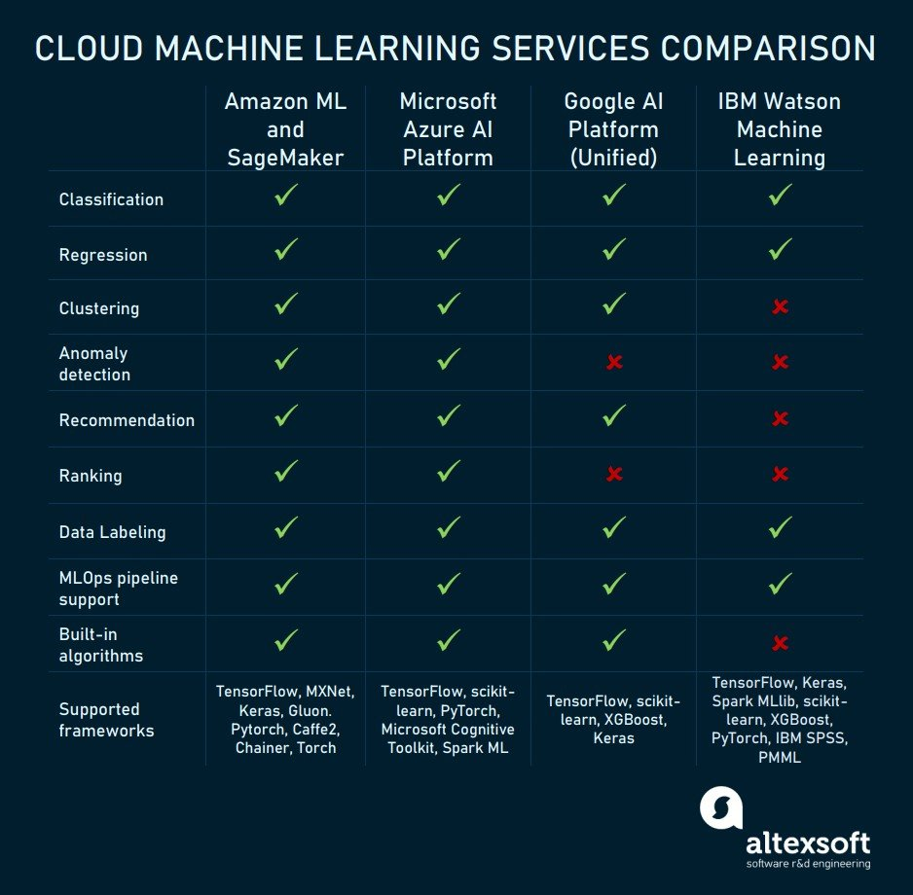

Slide 24
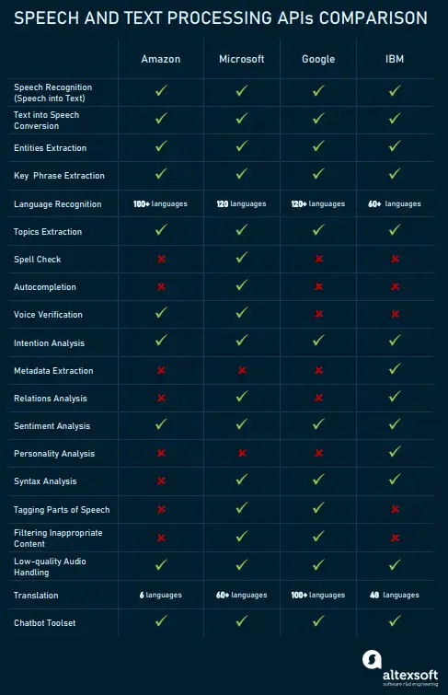

Slide 25
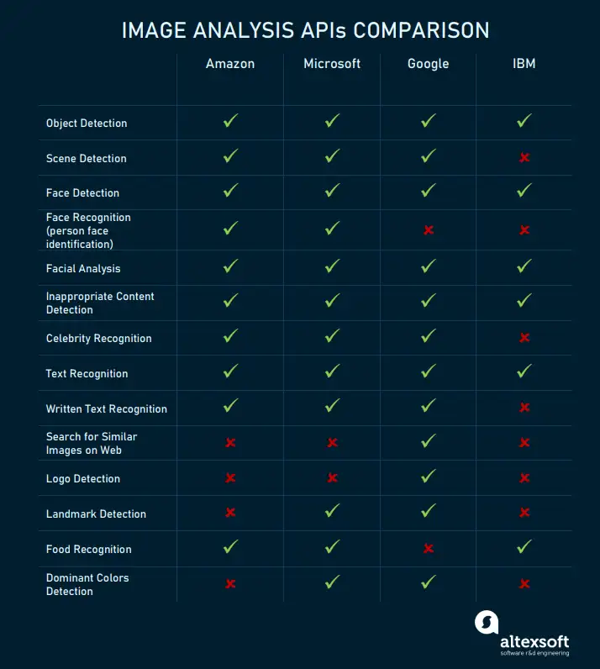

Slide 26
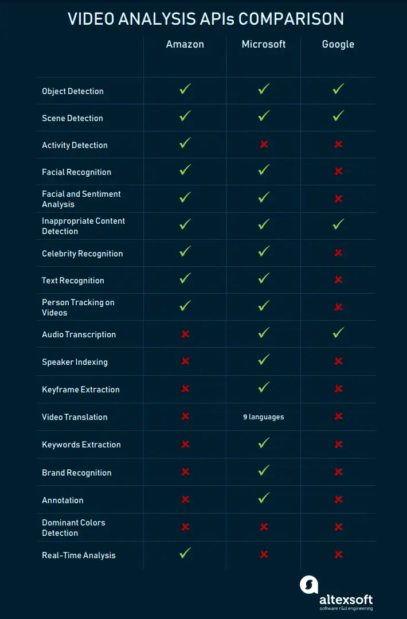

Slide 27
Conclusion
The future scope of AI and ML in Amazon is vast and holds immense potential across various domains. Here's a glimpse into its potential applications:
E-commerce and Retail:
Personalized shopping experiences: AI algorithms can further personalize product recommendations, predict customer behavior, and anticipate shoppers' needs with greater accuracy. This could lead to individualized product suggestions, targeted advertising, and dynamic pricing strategies.

Slide 28
Logistics and Warehousing
Robotics and automation: AI-powered robots will play a crucial role in warehouse automation, handling tasks like picking and packing, product sorting, and transportation within warehouses, achieving greater efficiency and accuracy.
Predictive maintenance: AI can anticipate machinery failures and schedule preventative maintenance, reducing downtime and increasing operational efficiency.
Cloud Computing and Web Services
Intelligent cloud infrastructure: AI can automate resource allocation and scaling in cloud environments, responding dynamically to user needs and improving resource utilization.

Slide 29

THANK YOU!

